Slide 1
Deep Reinforcement Learning
Yue Wang

Slide 2
content
What is reinforcement learning
How to solve reinforcement learning
Deep reinforcement learning

Slide 4
A simple example
Agent Environment
State Reward Action Observation Return
Exploration Exploitation

Slide 6
What is reinforcement learning
Machine learning
Supervised learning
Unsupervised learning
Reinforcement learning
y=f(x)
f(x)
y=f(a) r

Slide 7
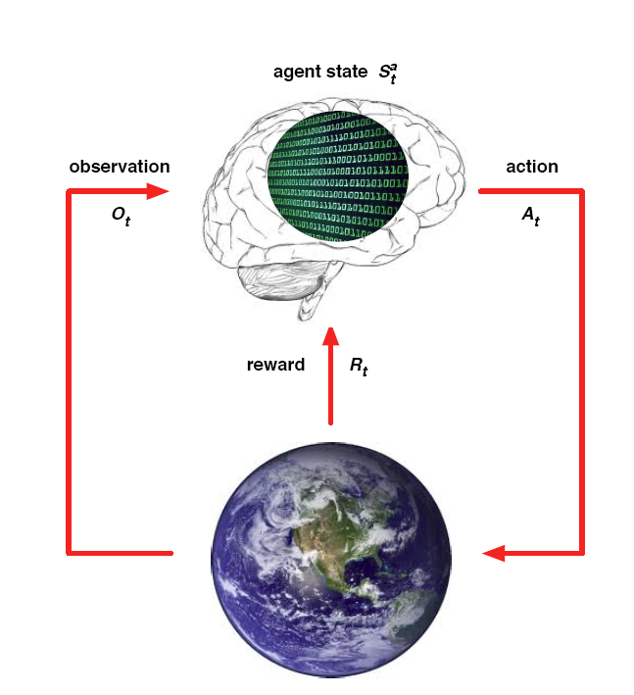
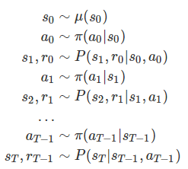
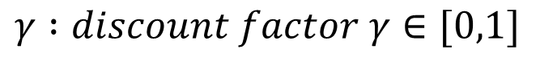
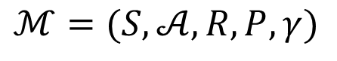
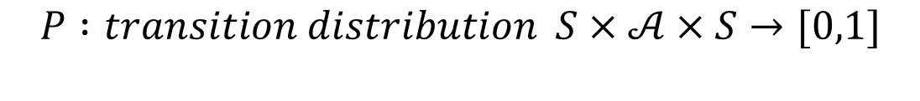
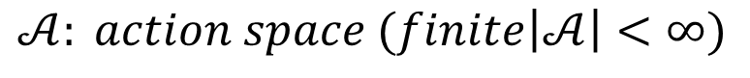
MDP
$$ℳ=(S,𝒜,R,P,γ)$$
$$S : state space is a (bounded) subset of the Euclidean space$$
$$𝒜: action space (finite\left|𝒜\right|<∞)$$
$$R :reward of a state−action pair S×𝒜×S→R$$
$$P :transition distribution S×𝒜×S→[0,1]$$
$$γ :discount factor γ∈[0,1]$$

Slide 8
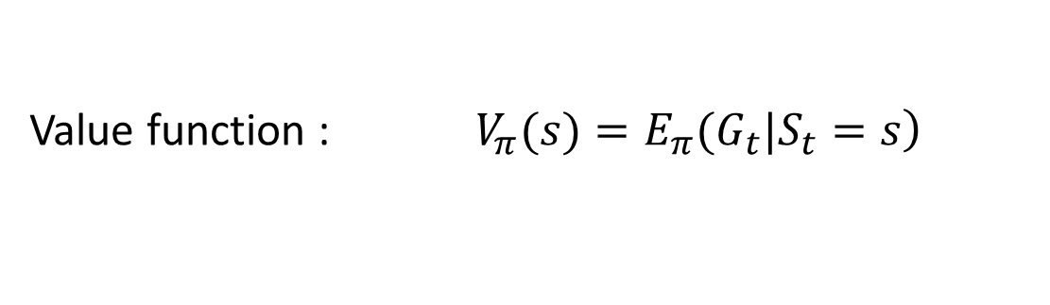
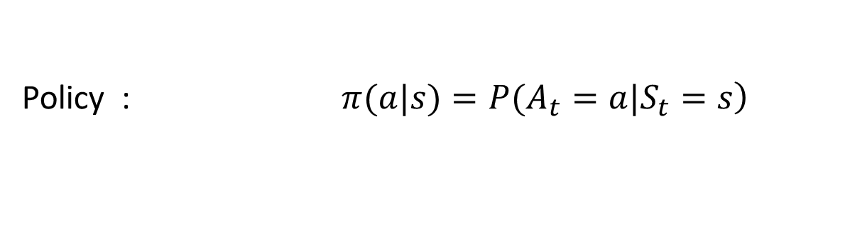
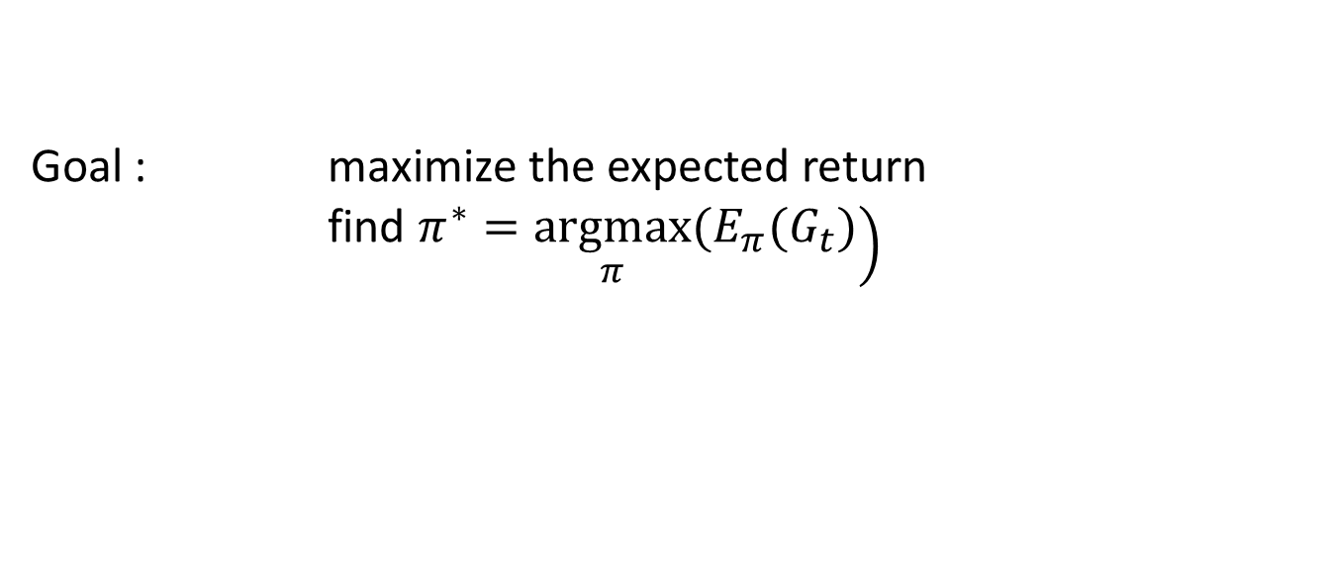
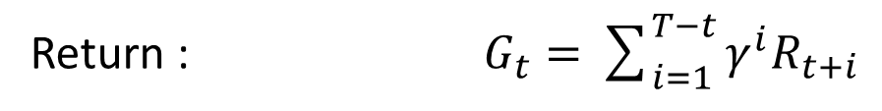
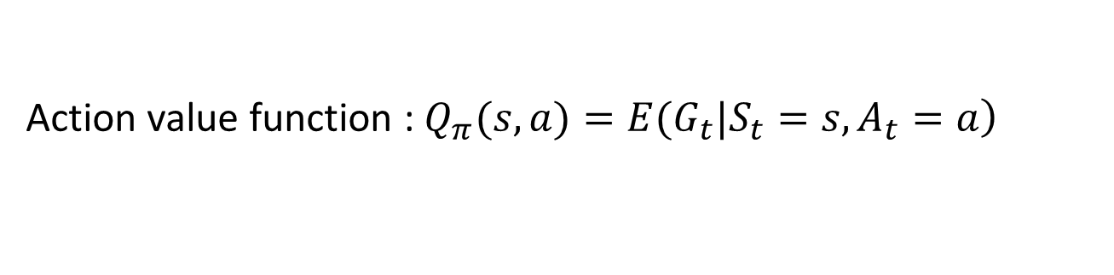
Reinforcement learning
Notation
Return : $G_{t}=\sum_{i=1}^{T−t}{γ^{i}R_{t+i}}$
Policy : $\left.π(a|s)=P(A_{t}=a|S_{t}=s\right)$
Value function : $\left.V_{π}(s)=E_{π}(G_{t}|S_{t}=s\right)$
Action value function : $\left.Q_{π}(s,a)=E(G_{t}|S_{t}=s,A_{t}=a\right)$
Goal : maximize the expected return
find $\left.π^{∗}=\underset{π}{argmax}(E_{π}(G_{t})\right)$

Slide 9
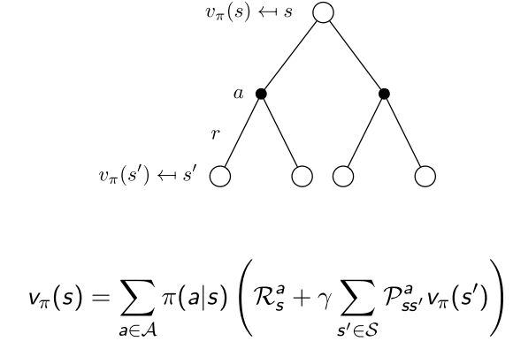
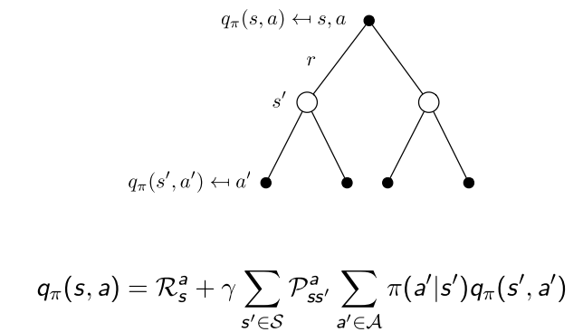
Value function
$$V^{π}\left(s\right)=E_{π}\left[r_{0}+γr_{1}+γ^{2}r_{2}+… | s_{0}=s\right]=R\left(s,π\left(s\right)\right)+γ E[V^{π}(π(s))]$$
$$Q^{π}\left(s\right)=E_{π}\left[r_{0}+γr_{1}+γ^{2}r_{2}+… | s_{0}=s,a_{0}=a\right]=R\left(s,a\right)+γ E[Q^{π}(s,π(s))]$$

Slide 10
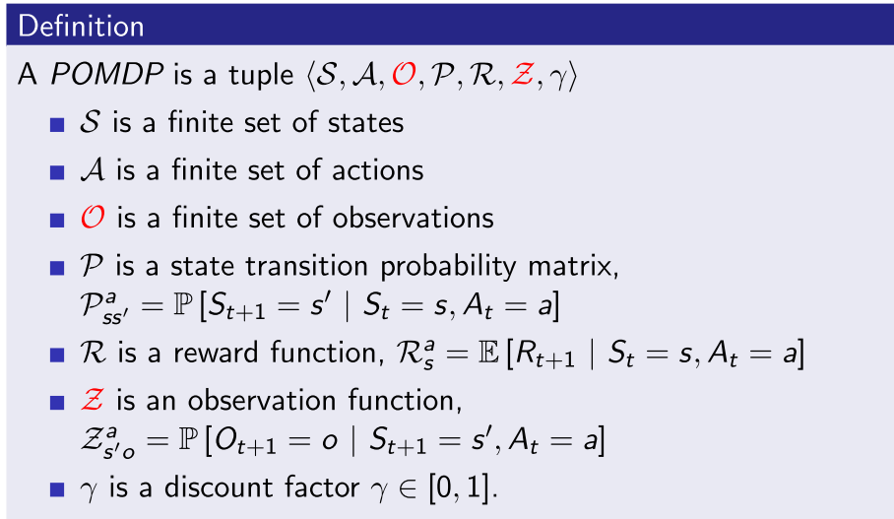
POMDP

Slide 11
POMDP
Markov Models |  | Do we have control over the state transitions?
 |  | No | Yes
Are the states completely observable? | Yes | Markov Chain | MDP
 | No | HMM Hidden Markov Model | POMDP Partially Observable Markov Decision Process

Slide 13
Algorithms
Value function based
DP
Policy iteration
Value iteration
MC
On policy
Off policy
TD
Sarsa
Q-learning
Policy Gradient
Reinforce
Actor-Critic

Slide 14
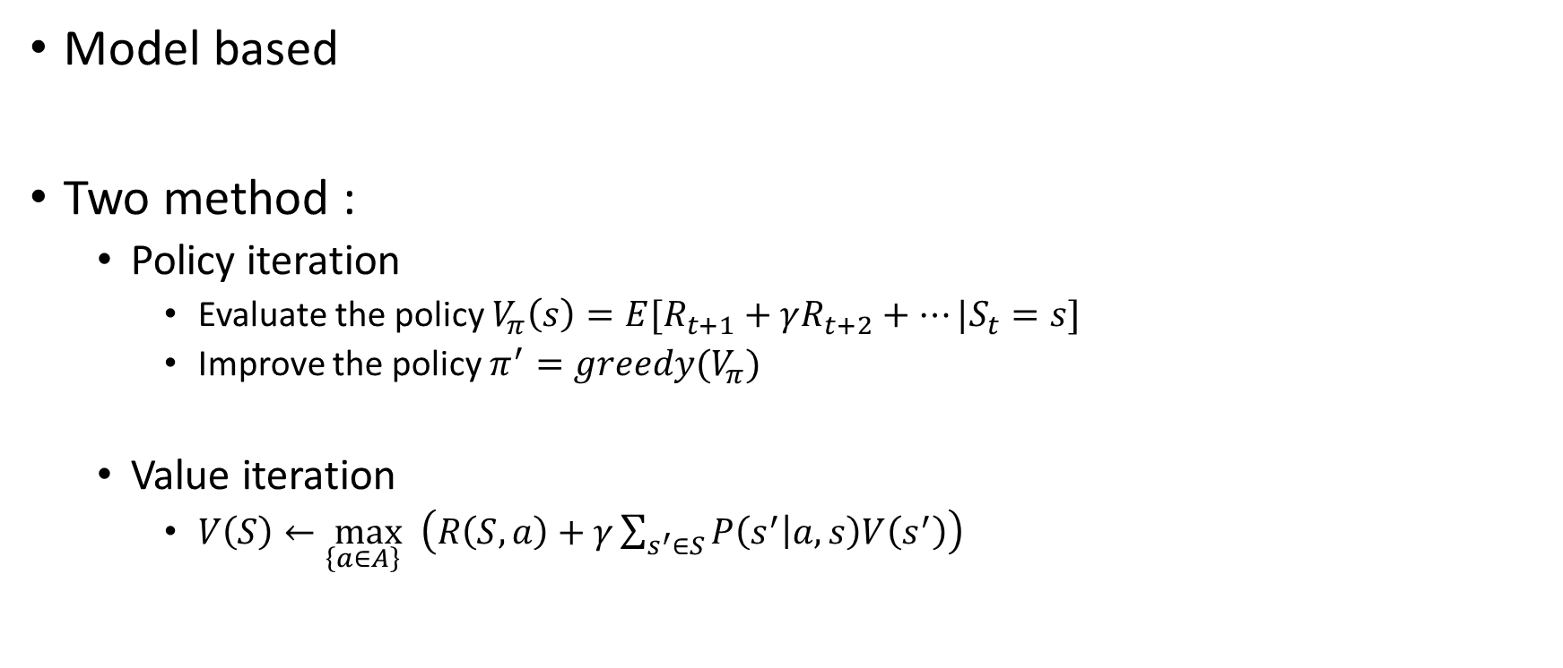
Algorithms DP (Dynamic Programming)
Model based
Two method :
Policy iteration
Evaluate the policy $V_{π}\left(s\right)=E[R_{t+1}+γR_{t+2}+…|S_{t}=s]$
Improve the policy $π^{′}=greedy(V_{π})$
Value iteration
$V\left(S\right)←\max_{\left\{a∈A\right\} }\left(R\left(S,a\right)+γ\sum_{s^{′}∈S}{P\left(s^{′} | a,s\right)V\left(s^{′}\right)}\right)$

Slide 15
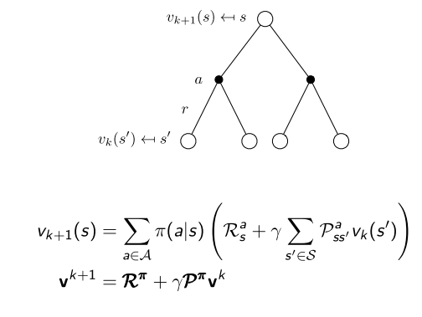
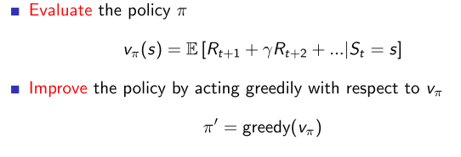
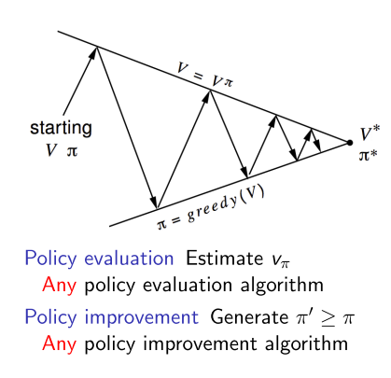
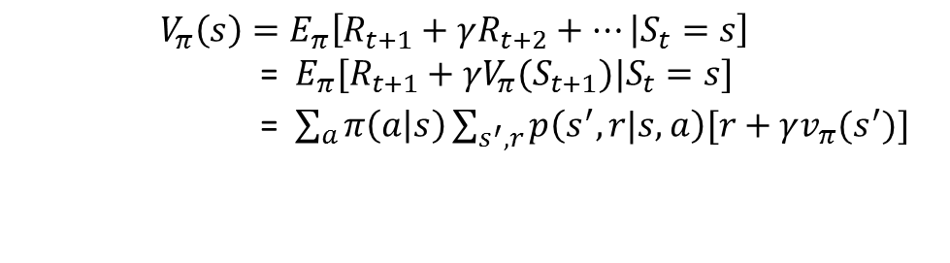
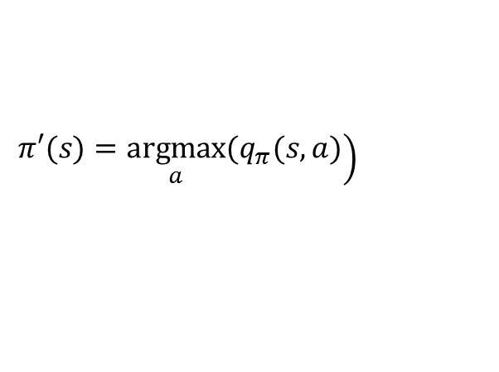
Policy iteration
Evaluate
Improve
$$V_{π}\left(s\right)=E_{π}\left[R_{t+1}+γR_{t+2}+… | S_{t}=s\right]$$
= $E_{π}[R_{t+1}+γV_{π}(S_{t+1})|S_{t}=s]$
=$\sum_{a}{π\left(a | s\right)\sum_{s^{′},r}{p\left(s^{′},r|s,a\right)[r+γv_{π}(s^{′})]}}$
$$\left.π′(s)=\underset{a}{argmax}(q_{π}(s,a)\right)$$

Slide 16
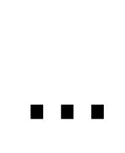
An example
0 | 0 | 0 | 0
0 | 0 | 0 | 0
0 | 0 | 0 | 0
0 | 0 | 0 | 0
0 | -1 | -1 | -1
-1 | -1 | -1 | -1
-1 | -1 | -1 | -1
-1 | -1 | -1 | 0
0 | -1.7 | -2.0 | -2.0
-1.7 | -2.0 | -2.0 | -2.0
-2.0 | -2.0 | -2.0 | -1.7
-2.0 | -2.0 | -1.7 | 0
0 | -2.4 | -2.9 | -3.0
-2.4 | -2.9 | -3.0 | -2.9
-2.9 | -3.0 | -2.9 | -2.4
-3.0 | -2.9 | -2.4 | 0
0 | -6.1 | -8.4 | -9.0
-6.1 | -7.7 | -8.4 | -8.4
-8.4 | -8.4 | -7.7 | -6.1
-9.0 | -8.4 | -6.1 | 0
$$…$$
One step convergence !

Slide 17
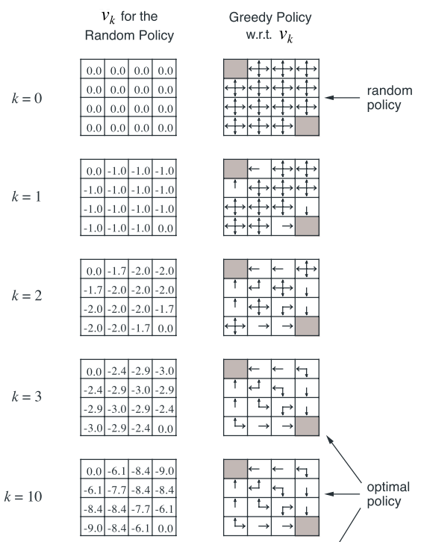
An example

Slide 18
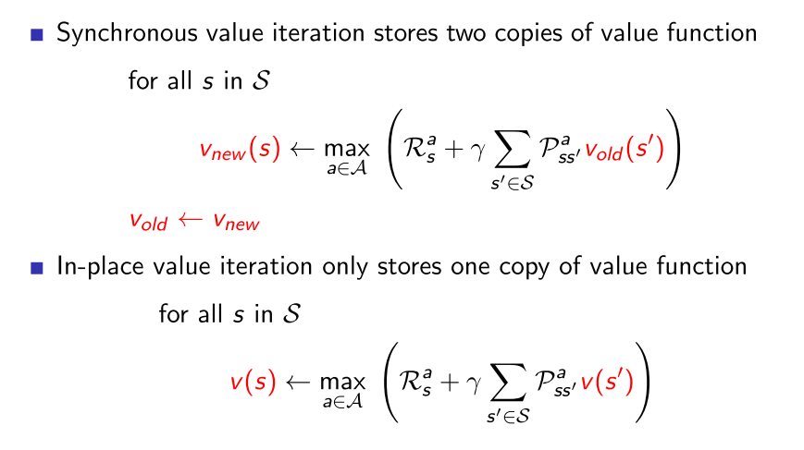
Value iteration

Slide 19
An example
0 | 0 | 0 | 0
0 | 0 | 0 | 0
0 | 0 | 0 | 0
0 | 0 | 0 | 100
0 | -1 | -1 | -1
-1 | -1 | -1 | -1
-1 | -1 | -1 | 99
-1 | -1 | 99 | 100
0 | -1 | -2 | -2
-1 | -2 | -2 | 98
-2 | -2 | 98 | 99
-2 | 98 | 99 | 100
0 | -1 | -2 | 97
-1 | -2 | 97 | 98
-2 | 97 | 98 | 99
97 | 98 | 99 | 100
0 | -1 | 96 | 97
-1 | 96 | 97 | 98
96 | 97 | 98 | 99
97 | 98 | 99 | 100
0 | 95 | 96 | 97
95 | 96 | 97 | 98
96 | 97 | 98 | 99
97 | 98 | 99 | 100
Convergence !

Slide 20
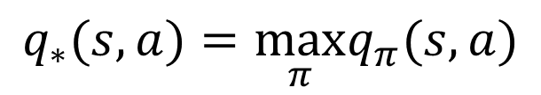
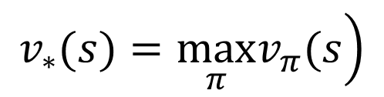
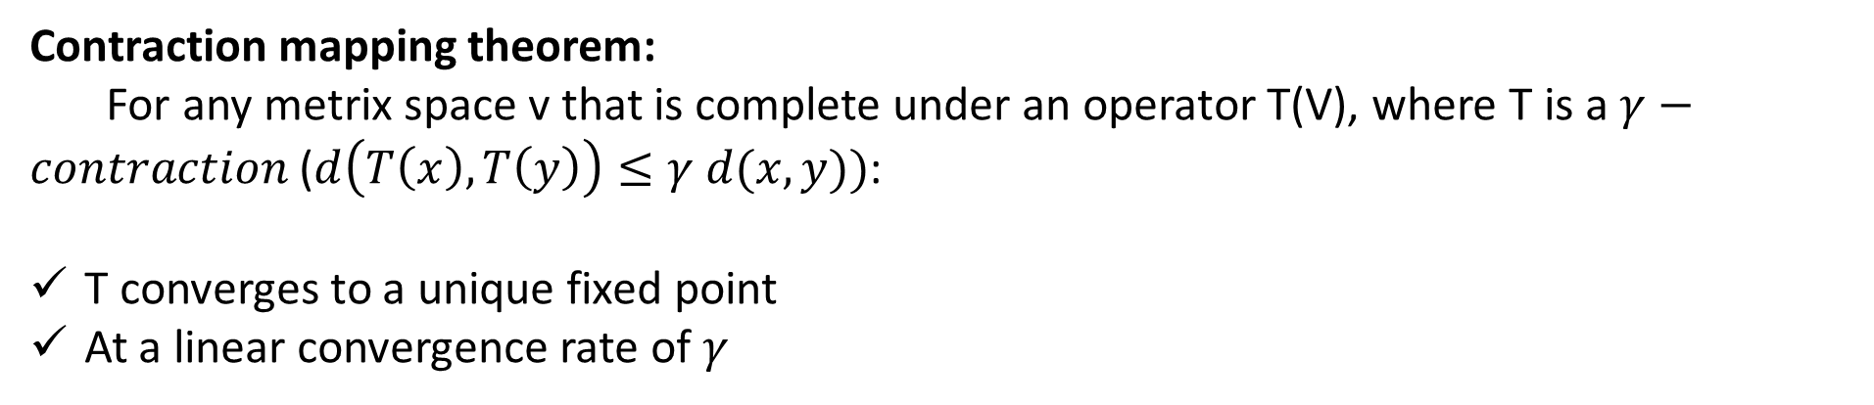
Optimal value function
$$\left.v_{∗}(s)=\max_{π}v_{π}(s\right)$$
$$q_{∗}(s,a)=\max_{π}q_{π}(s,a)$$
$$v_{∗}(s)=\max_{a}E\left[R_{t+1}+γv_{∗}\left(S_{t+1}\right) | S_{t}=s,A_{t}=a\right]=\max_{a}\sum_{s^{′},r}{\left.p(s^{′},r|s,a)[r+γv_{∗}(s^{′})\right]}$$
$$\left.q_{∗}(s,a)=E[R_{t+1}+γ\max_{a′}q_{∗}(S_{t+1},a′)|S_{t}=s,A_{t}=a\right]\text{=}\sum_{s^{′},r}{\left.p(s^{′},r|s,a)[r+γ\max_{a}q_{∗}(s^{′},a′)\right]}$$
Contraction mapping theorem:
For any metrix space v that is complete under an operator T(V), where T is a $γ−contraction$ ($d\left(T\left(x\right),T\left(y\right)\right)≤γ d(x,y))$:
T converges to a unique fixed point
At a linear convergence rate of $γ$

Slide 21
Algorithms MC (Monte Carlo)
Model free
Episodic MDP
value = mean return
On policy and off policy !

Slide 22
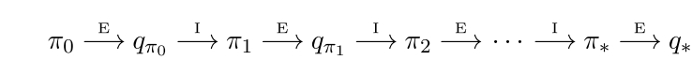
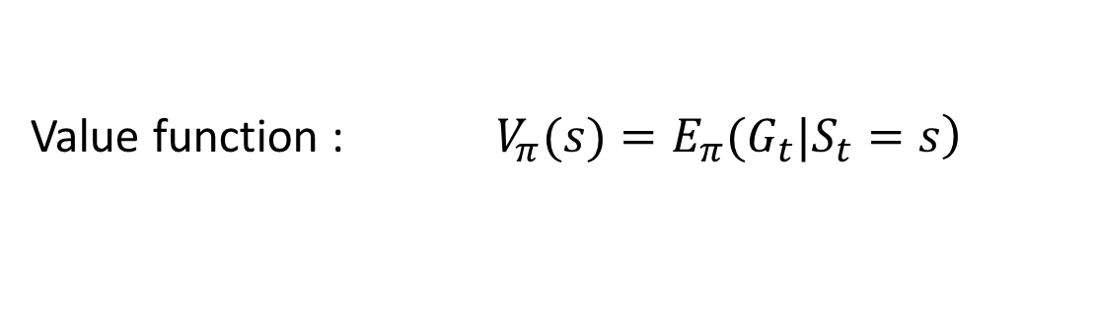
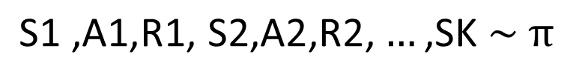
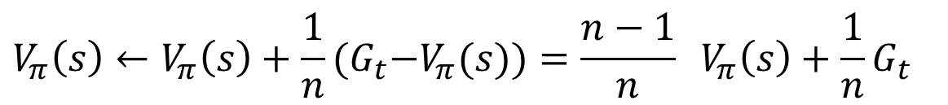
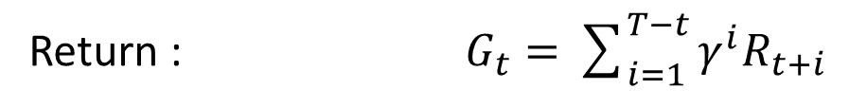
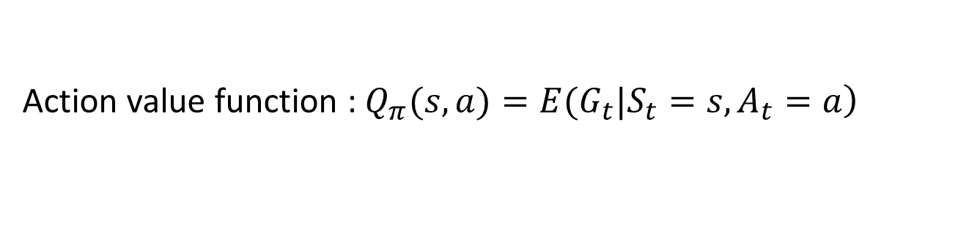
Initial MC algorithms
Return : $G_{t}=\sum_{i=1}^{T−t}{γ^{i}R_{t+i}}$
Value function : $\left.V_{π}(s)=E_{π}(G_{t}|S_{t}=s\right)$
Action value function : $\left.Q_{π}(s,a)=E(G_{t}|S_{t}=s,A_{t}=a\right)$
$$\text{S}\text{1 ,}\text{A}\text{1,}\text{R}\text{1, }\text{S}\text{2,}\text{A}\text{2,}\text{R}\text{2,}…\text{,}\text{SK} \sim π$$
E for policy evaluation
I for policy improvement
$$V_{π}\left(s\right)←V_{π}\left(s\right)+\frac{1}{n}{(G}_{t}−V_{π}(s))=\frac{n−1}{n} V_{π}\left(s\right)+\frac{1}{n}G_{t}$$
Is there any problem ? Recall the simple game before we start.
Trade off between exploration and exploitation

Slide 23
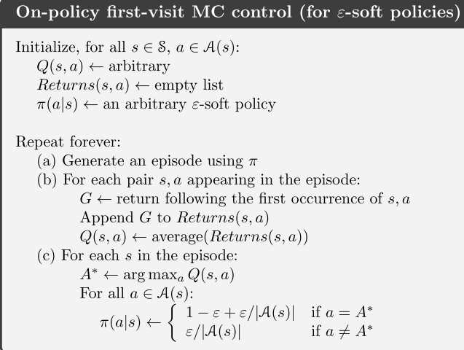
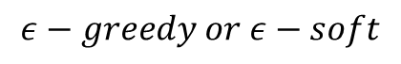
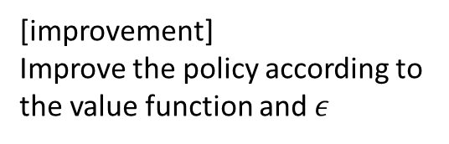
On policy and off policy
$$ε−greedy or ε−soft$$
[evaluation]
Compute the value function according to the expectation
[improvement]
Improve the policy according to the value function and $ε$

Slide 24
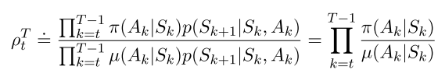
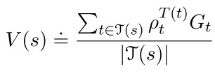
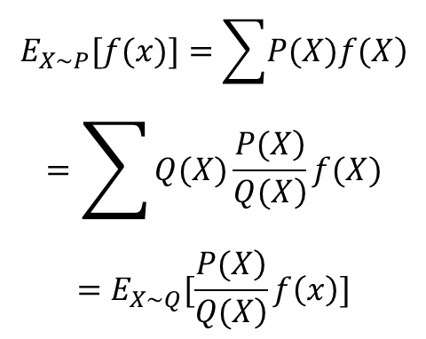
On policy and off policy
Behavior policy and Target policy are different
Through importance sampling( Measure Transformation ) to adjust the expectation
$$\begin{matrix}E_{X\sim P}[f(x)]=\sum{\left.P(X)f(X\right)} \\ =\sum{Q(X)\frac{\left.P(X\right)}{\left.Q(X\right)}f(X}) \\ =E_{X\sim Q}[\frac{\left.P(X\right)}{\left.Q(X\right)}f\left(x\right)]\end{matrix}$$

Slide 25
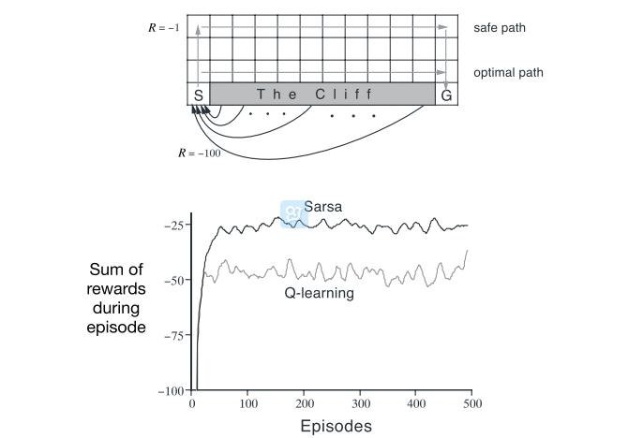
An example

Slide 26
Algorithms TD (Temporal Difference)
Model free
Three important methods :
TD(0)
Sarsa
Q-leaning

Slide 27
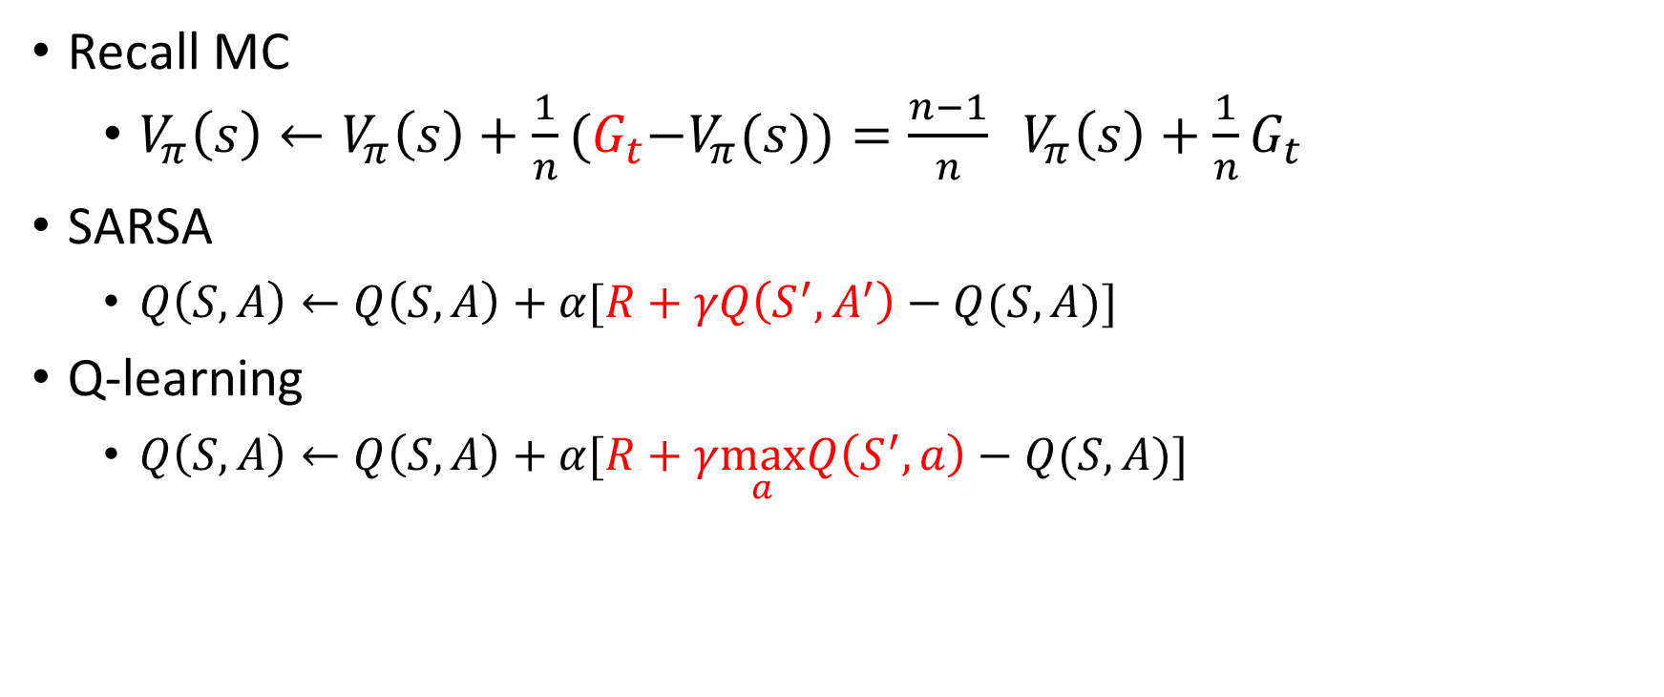
TD
Recall MC
$V_{π}\left(s\right)←V_{π}\left(s\right)+\frac{1}{n}{(G}_{t}−V_{π}(s))=\frac{n−1}{n} V_{π}\left(s\right)+\frac{1}{n}G_{t}$
SARSA
$Q\left(S,A\right)←Q\left(S,A\right)+α[R+γQ\left(S^{′},A^{′}\right)−Q(S,A)]$
Q-learning
$Q\left(S,A\right)←Q\left(S,A\right)+α[R+γ\max_{a}Q\left(S^{′},a\right)−Q(S,A)]$

Slide 28
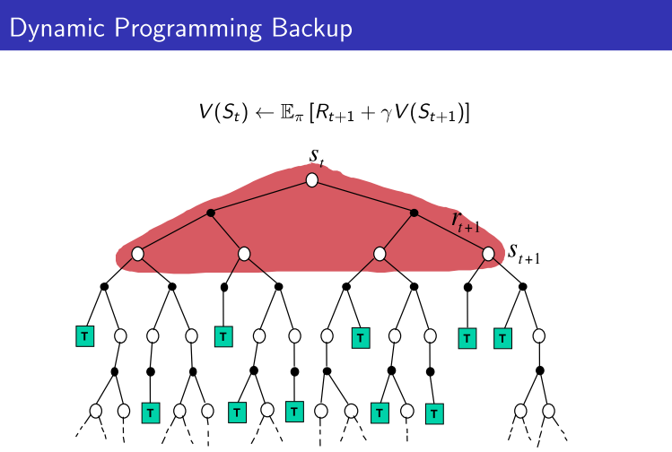
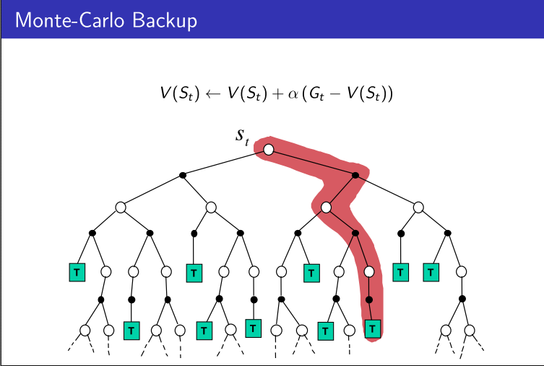
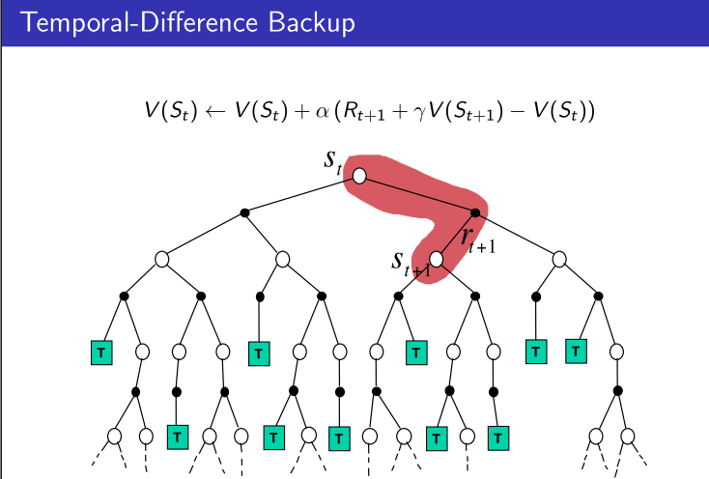
 | Markov Property | Bootstrapping | sampling
DP | Yes | Yes | No
MC | No | No | Yes
TD | Yes | Yes | Yes

Slide 29
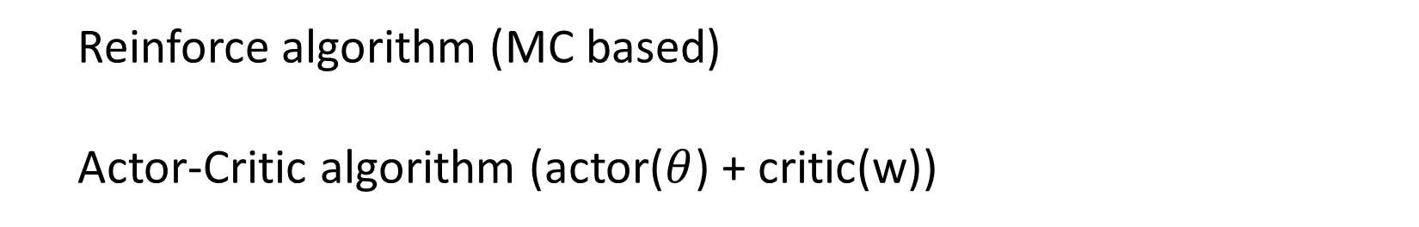
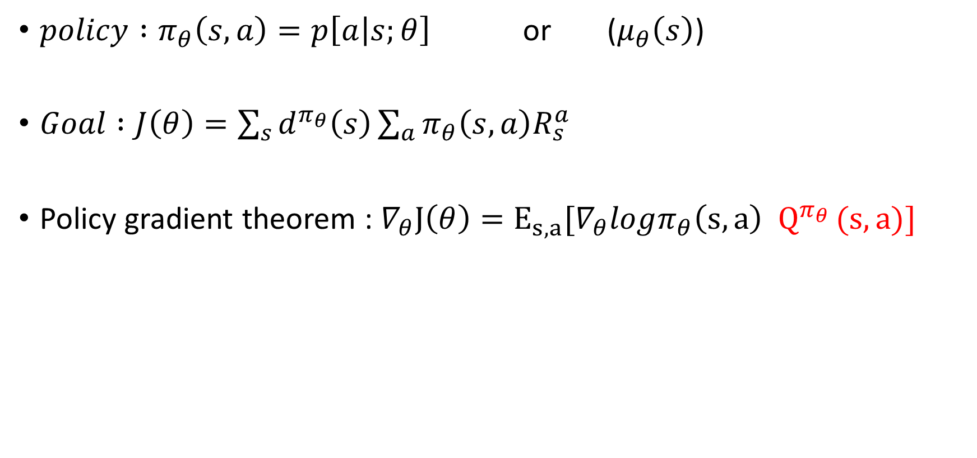
Policy Gradient
$policy :π_{θ}\left(s,a\right)=p\left[a | s;θ\right]$ or ($μ_{θ}\left(s\right)$)
$Goal :J\left(θ\right)=\sum_{s}{d^{π_{θ}}\left(s\right)\sum_{a}{π_{θ}\left(s,a\right)R_{s}^{a}}}$
Policy gradient theorem : $∇_{θ}J\left(θ\right)=E_{s,a}[∇_{θ}logπ_{θ}\left(s,a\right) Q^{π_{θ} }(s,a)]$
Reinforce algorithm (MC based)
Actor-Critic algorithm (actor($θ$) + critic(w))

Slide 31
Problems
Recall :
Value function and policy
Function approximation
Policy improve need max operation vs Continues control
Policy gradient

Slide 32
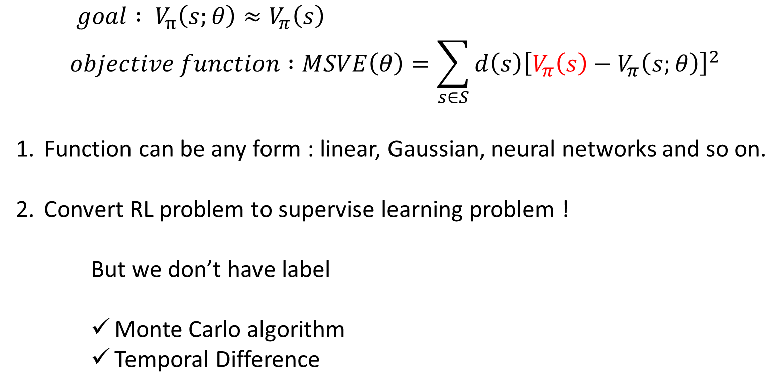
Function approximation
$$goal : V_{π}\left(s;θ\right)≈V_{π}\left(s\right)$$
$$objective function :MSVE\left(θ\right)=\sum_{s∈S}{d\left(s\right){\left[V_{π}\left(s\right)−V_{π}\left(s;θ\right)\right]}^{2}}$$
Function can be any form : linear, Gaussian, neural networks and so on.
Convert RL problem to supervise learning problem !
But we don’t have label
Monte Carlo algorithm
Temporal Difference

Slide 33
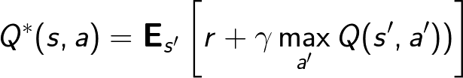
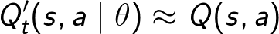
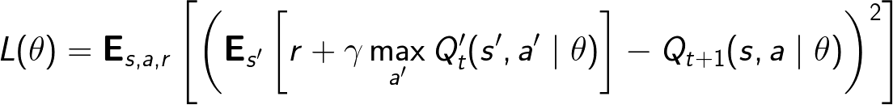
An example
$$Q learning : Q\left(S,A\right)←Q\left(S,A\right)+α[R+γ\max_{a}Q\left(S^{′},a\right)−Q(S,A)]$$

Slide 34
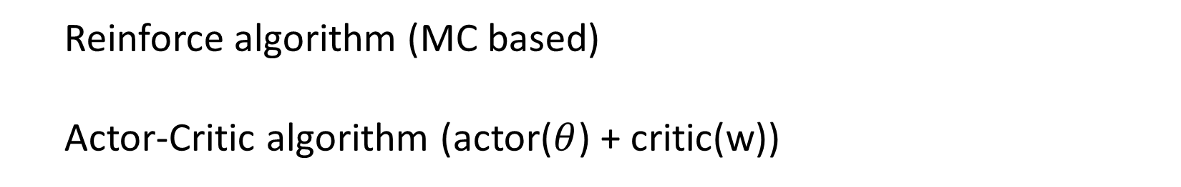

Policy Gradient
$policy :π_{θ}\left(s,a\right)=p\left[a | s;θ\right]$
$Goal :J\left(θ\right)=\sum_{s}{d^{π_{θ}}\left(s\right)\sum_{a}{π_{θ}\left(s,a\right)R_{s}^{a}}}$
Policy gradient theorem :
$$∇_{θ}J\left(θ\right)=\iint_{s,a}{d^{π_{θ}}(s)π_{θ}\left(s,a\right)∇_{θ}logπ_{θ}(s,a){(Q}^{π_{θ} }\left(s,a\right))dsda}$$
$$=E[∇_{θ}logπ_{θ}\left(s,a\right) {(Q}^{π_{θ} }\left(s,a\right))]$$
Reinforce algorithm (MC based)
Actor-Critic algorithm (actor($θ$) + critic(w))

Slide 36

Deep Neural Network

Slide 37

Deep Neural Network

Slide 38
Deep reinforcement learning
Improvement of RL
Deep neural network to approximate functions in RL
Express abstract and complex function relation
End to end task
Implementation of DRL
The definition of objection
Deep value function (DQN)
Deep policy approximation (DDPG)
Problems bring by deep learning
No convergence guarantee
Train slowly

Slide 39



An example (QDN)

Slide 40


An example (DDPG) (deterministic deep policy gradient)
Input:
state
Nonlinear transform:
Parameter $θ^{π}$
Output:
action
Input:
action
Nonlinear transform :
Parameter $θ^{Q}$
Output:
Q value
Input:
state
Gradient descent

Slide 41
Convergence issue
Some trick
Asynchronous
Variance reduce
others

Slide 42

Some trick
Use experience replay
Store transition ${(s}_{t},a_{t},r_{t+1},s_{t+1})$ in D
Randomly sample mini-batch
Use mini-batch to optimize the target
Freeze target Q-network
$L\left(w\right)=E[{\left(R+γQ\left(S^{′},a^{′},w\right)−Q\left(S,a,w\right)\right)}^{2}]$
$L\left(w\right)=E[{\left(R+γQ\left(S^{′},a^{′},w^{−}\right)−Q\left(S,a,w\right)\right)}^{2}]$
Double Q-learning
$Y_{t}^{Q}=R_{t+1}+γQ(S_{t+1},argmax_{a}Q\left(S_{t+1},a;θ_{t}\right);θ_{t})$
$Y_{t}^{DoubleQ}=R_{t+1}+γQ(S_{t+1},argmax_{a}Q\left(S_{t+1},a;θ_{t}\right);{θ′}_{t})$
Clip rewards or normalize network
Advantage decompose
$Q\left(S,A\right)=V\left(S\right)+A(S,A)$

Slide 43

Asynchronous
Mnih, Volodymyr, et al. "Asynchronous methods for deep reinforcement learning." arXiv preprint arXiv:1602.01783 (2016).

Slide 44

Variance reduce
Zhao, Tingting, et al. "Analysis and improvement of policy gradient estimation." Advances in Neural Information Processing Systems. 2011.
Reinforce
PGPE : $J\left(ρ\right)=\iint_{s,a}{π_{θ}\left(s,a\right)p\left(θ | ρ\right)Q^{π_{θ}}}\left(s,a\right)dsda$
Reinforce with baseline
$∇_{θ}J\left(θ\right)=E[∇_{θ}logπ_{θ}\left(s,a\right) {(Q}^{π_{θ} }\left(s,a\right)−b\left(s\right))]=\iint_{s,a}{d^{π_{θ}}(s)π_{θ}\left(s,a\right)∇_{θ}logπ_{θ}(s,a){(Q}^{π_{θ} }\left(s,a\right)−b\left(s\right))dsda}$
Greensmith, Evan, Peter L. Bartlett, and Jonathan Baxter. "Variance reduction techniques for gradient estimates in reinforcement learning."Journal of Machine Learning Research 5.Nov (2004): 1471-1530.

Slide 45

My thinking
Is there any theoretical analysis of the convergence about RL algorithms and functional approximation？

Slide 46
My thinking
Many tricks and improvements make algorithms work for real task.
It seems most of them only have intuitive explanation.
Such as advantage decomposition.
Can we give some theoretical explanation about these tricks and improvements.

Slide 47
My thinking
Analysis
Understand
Improve

Slide 48
Thanks

